Slide 1

Chapter 7
ARP and RARP
Objectives
Upon completion you will be able to:
Understand the need for ARP
Understand the cases in which ARP is used
Understand the components and interactions in an ARP package
Understand the need for RARP

Slide 2
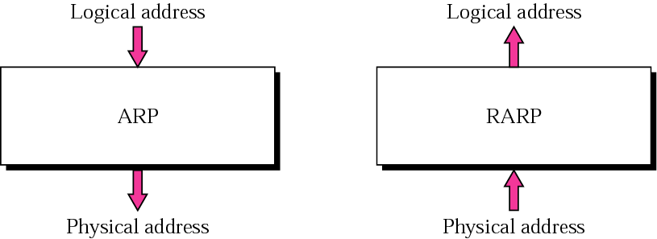
Figure 7.1 ARP and RARP

Slide 3
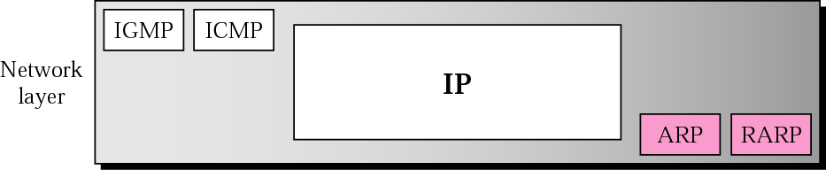
Figure 7.2 Position of ARP and RARP in TCP/IP protocol suite

Slide 4
7.1 ARP
ARP associates an IP address with its physical address. On a typical physical network, such as a LAN, each device on a link is identified by a physical or station address that is usually imprinted on the NIC.
The topics discussed in this section include:
Packet Format
Encapsulation
Operation
ARP over ATM
Proxy ARP

Slide 5
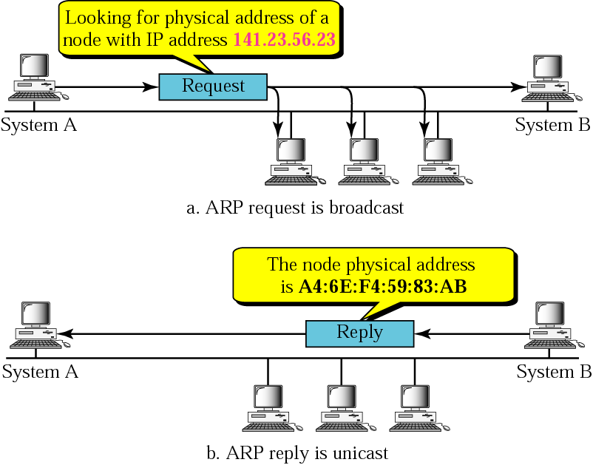
Figure 7.3 ARP operation

Slide 6
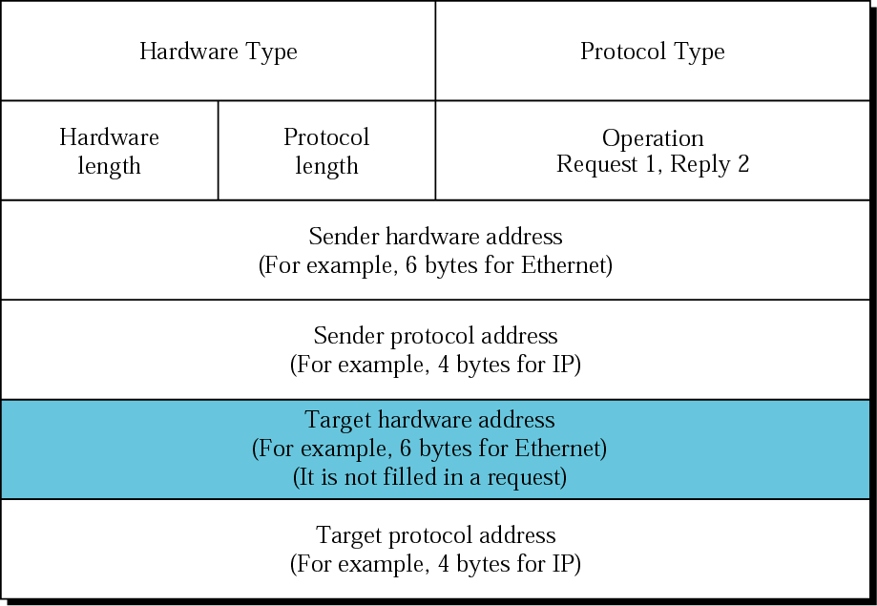
Figure 7.4 ARP packet

Slide 7
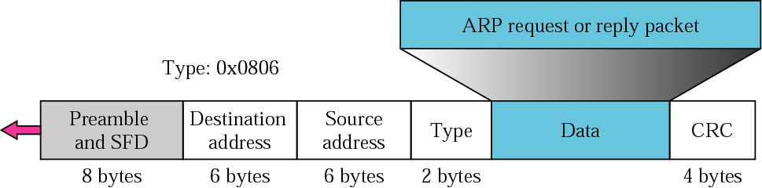
Figure 7.5 Encapsulation of ARP packet

Slide 8
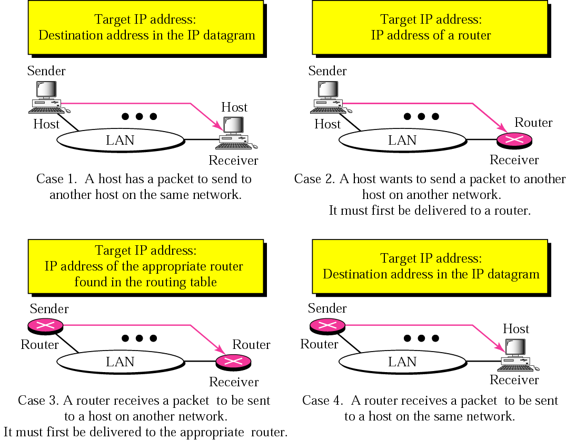
Figure 7.6 Four cases using ARP

Slide 9

Note:
An ARP request is broadcast;
an ARP reply is unicast.

Slide 10
Example 1
A host with IP address 130.23.43.20 and physical address B2:34:55:10:22:10 has a packet to send to another host with IP address 130.23.43.25 and physical address A4:6E:F4:59:83:AB (which is unknown to the first host). The two hosts are on the same Ethernet network. Show the ARP request and reply packets encapsulated in Ethernet frames.
See Next Slide

Slide 11
Example 1 (Continued)
Solution
Figure 7.7 shows the ARP request and reply packets. Note that the ARP data field in this case is 28 bytes, and that the individual addresses do not fit in the 4-byte boundary. That is why we do not show the regular 4-byte boundaries for these addresses. Also note that the IP addresses are shown in hexadecimal. For information on binary or hexadecimal notation see Appendix B.
See Next Slide

Slide 12
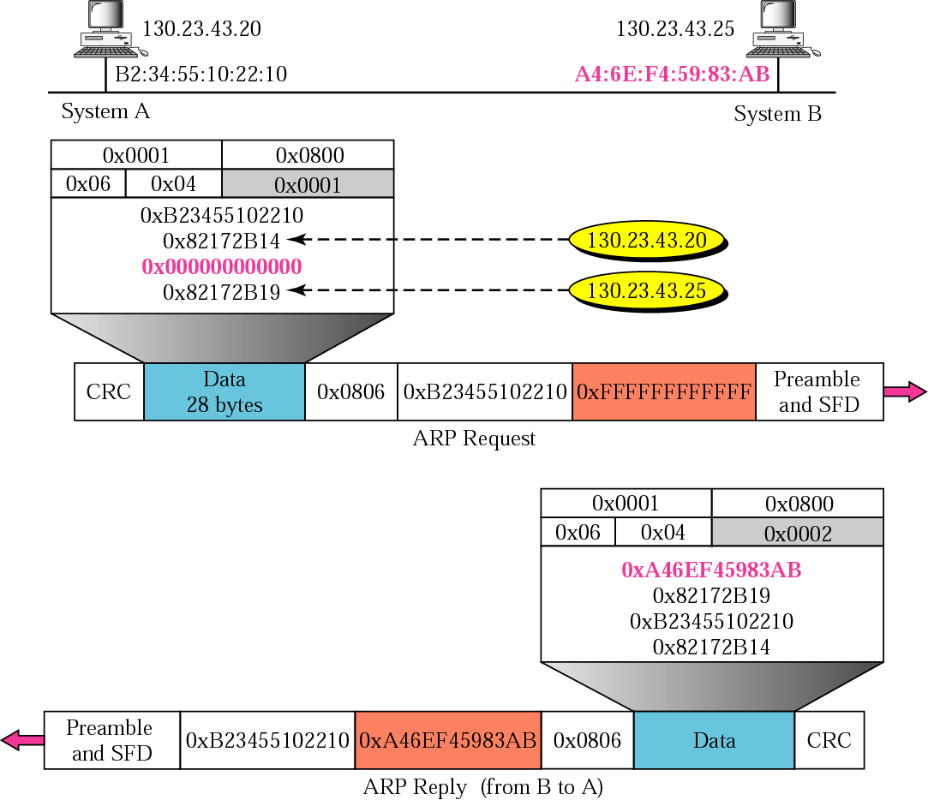
Figure 7.7 Example 1

Slide 13
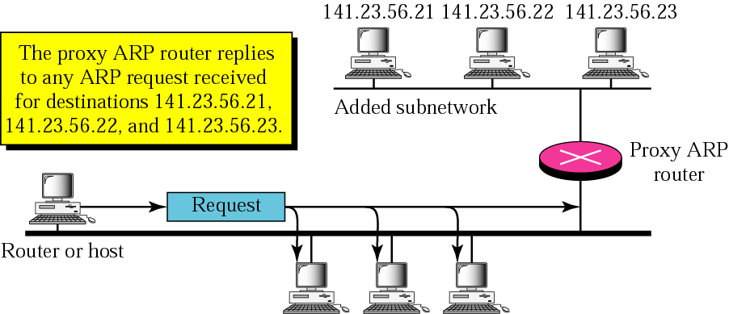
Figure 7.8 Proxy ARP

Slide 14
7.2 ARP PACKAGE
In this section, we give an example of a simplified ARP software package to show the components and the relationships between the components. This ARP package involves five modules: a cache table, queues, an output module, an input module, and a cache-control module.
The topics discussed in this section include:
Cache Table
Queues
Output Module
Input Module
Cache-Control Module

Slide 15
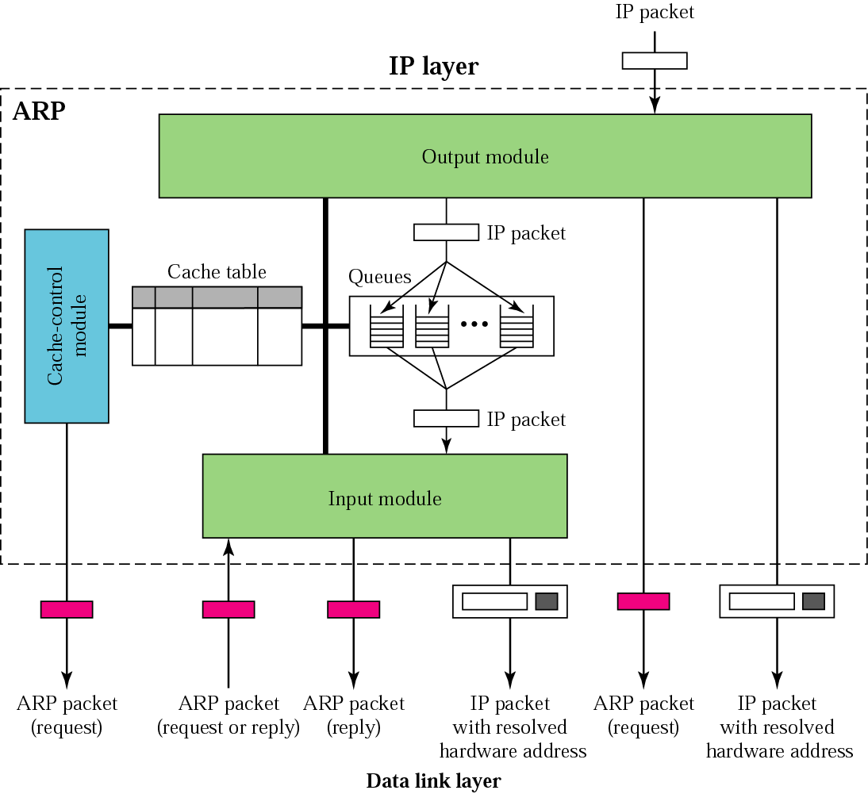
Figure 7.9 ARP components

Slide 16
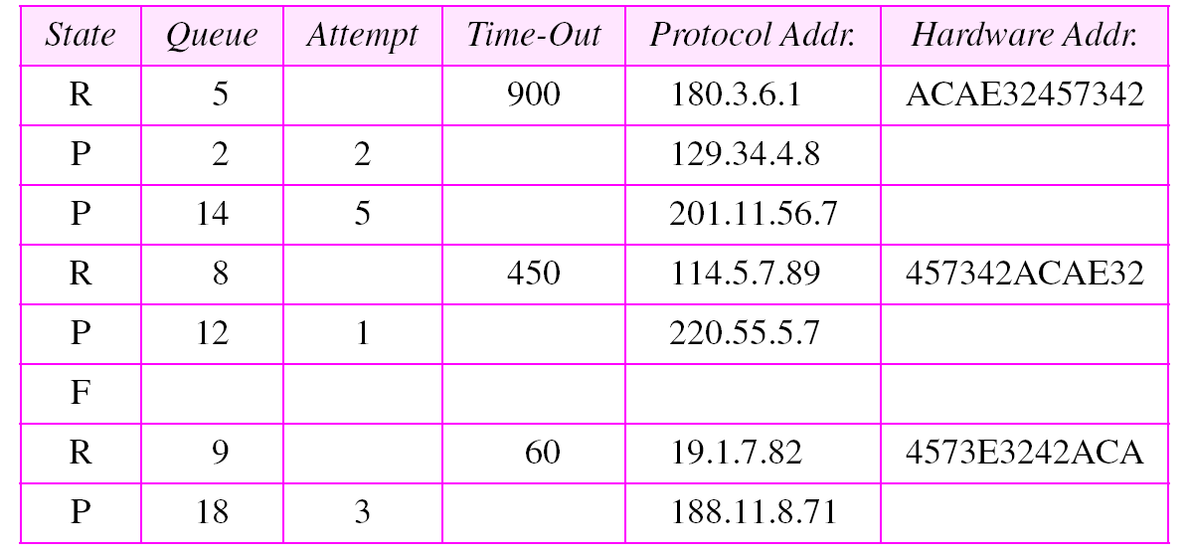
Table 7.1 Original cache table used for examples

Slide 17
Example 2
The ARP output module receives an IP datagram (from the IP layer) with the destination address 114.5.7.89. It checks the cache table and finds that an entry exists for this destination with the RESOLVED state (R in the table). It extracts the hardware address, which is 457342ACAE32, and sends the packet and the address to the data link layer for transmission. The cache table remains the same.

Slide 18
Example 3
Twenty seconds later, the ARP output module receives an IP datagram (from the IP layer) with the destination address 116.1.7.22. It checks the cache table and does not find this destination in the table. The module adds an entry to the table with the state PENDING and the Attempt value 1. It creates a new queue for this destination and enqueues the packet. It then sends an ARP request to the data link layer for this destination. The new cache table is shown in Table 7.2.
See Next Slide

Slide 19
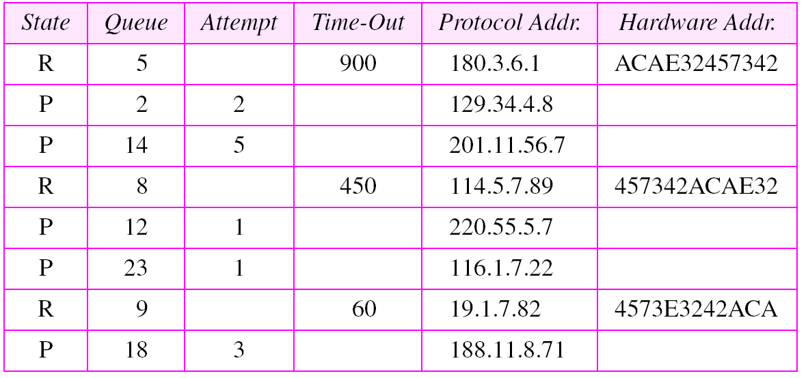
Table 7.2 Updated cache table for Example 3

Slide 20
Example 4
Fifteen seconds later, the ARP input module receives an ARP packet with target protocol (IP) address 188.11.8.71. The module checks the table and finds this address. It changes the state of the entry to RESOLVED and sets the time-out value to 900. The module then adds the target hardware address (E34573242ACA) to the entry. Now it accesses queue 18 and sends all the packets in this queue, one by one, to the data link layer. The new cache table is shown in Table 7.3.
See Next Slide

Slide 21
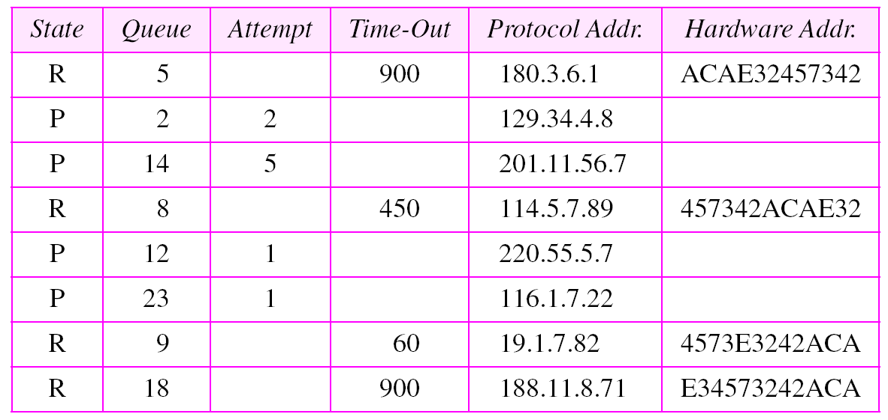
Table 7.3 Updated cache table for Example 4

Slide 22
Example 5
Twenty-five seconds later, the cache-control module updates every entry. The time-out values for the first three resolved entries are decremented by 60. The time-out value for the last resolved entry is decremented by 25. The state of the next-to-the last entry is changed to FREE because the time-out is zero. For each of the three pending entries, the value of the attempts
See Next Slide

Slide 23
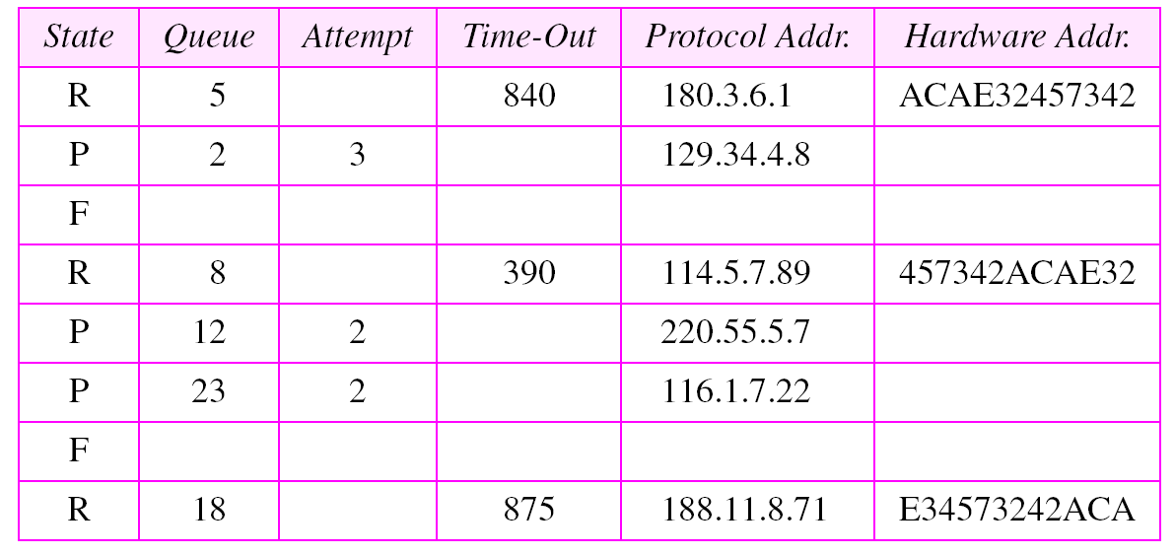
Table 7.4 Updated cache table for Example 5

Slide 24
7.3 RARP
RARP finds the logical address for a machine that only knows its physical address.
The topics discussed in this section include:
Packet Format
Encapsulation
RARP Server
Alternative Solutions to RARP

Slide 25
Note:
The RARP request packets are broadcast;
the RARP reply packets are unicast.

Slide 26
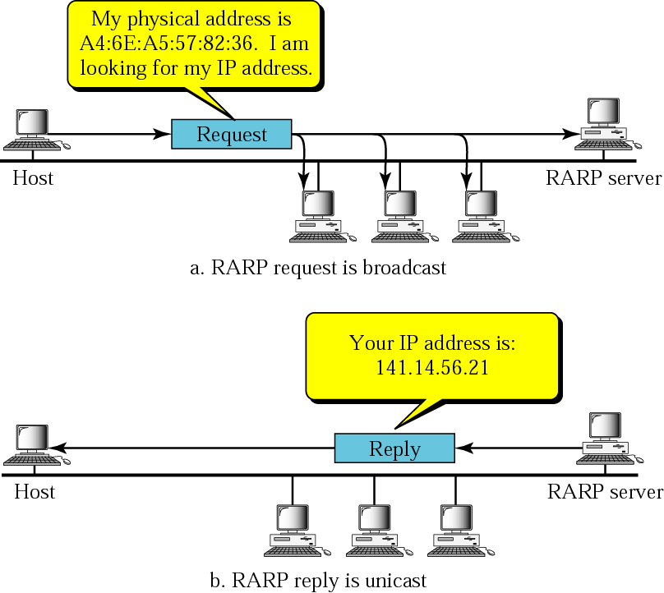
Figure 7.10 RARP operation

Slide 27
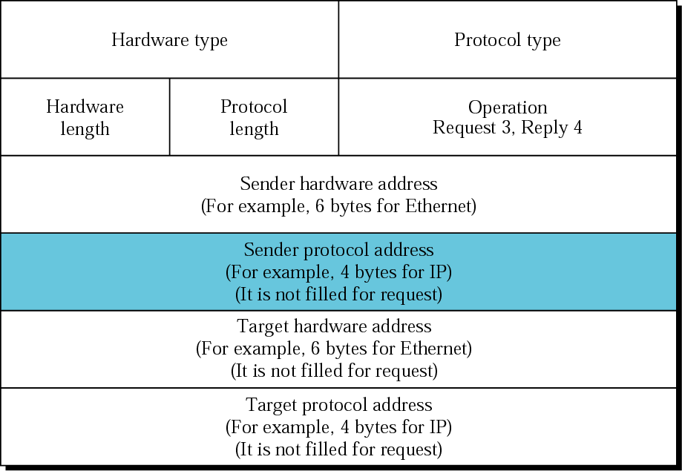
Figure 7.11 RARP packet

Slide 28
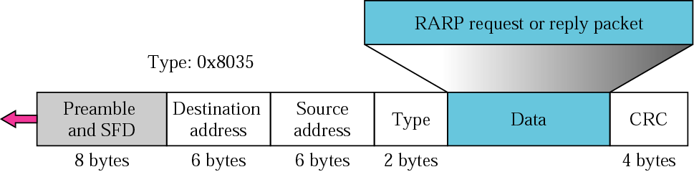
Figure 7.12 Encapsulation of RARP packet

